Slide 1
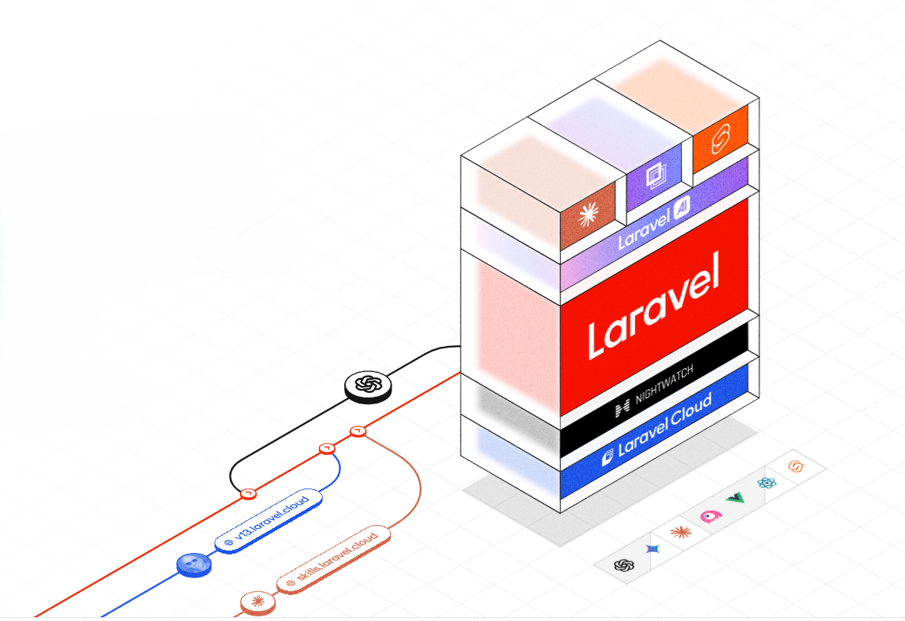
Writing Clean Code in
Modern Laravel

Slide 2
ENGINEERING MINDSET
The Clean Code Philosophy: Craftsmanship & Care
“Anyone can write code that a computer can understand. Good programmers write code that humans can understand.”
— Martin Fowler (Refactoring), (Jamie Peters: 'Writing code every day is not a job, it is a craft.')
1. Readability Over Cleverness
Code is read 10x more often than it is written. Optimize for the engineer debugging a midnight ICU emergency in 3 years, not for writing the shortest one-liner today.
2. Predictability & Zero Surprises
Methods should do exactly what their names imply—nothing more, nothing hidden. Avoid unexpected side-effects, hidden state mutations, and silent failures.
3. Maintainability (10-Year Horizon)
HMIS is an enterprise foundation for a Hospital. Writing clean code keeps our velocity fast even as the system grows to 50+ modules.

Slide 3
The Zen of Python vs. The Zen of Laravel
The Zen of Python (import this) | The Zen of Laravel (The Artisan Way)
▪ Beautiful is better than ugly. | → Elegance and developer joy come first.
▪ Explicit is better than implicit. | → Convention over configuration, but explicit at data boundaries.
▪ Simple is better than complex. | → Pragmatic solutions beat over-abstracted architecture.
▪ Flat is better than nested. | → Guard clauses and early returns over arrow anti-patterns.
▪ Readability counts. | → Code should read like expressive prose.
▪ Errors should never pass silently. | → Domain exceptions over silent false/null returns.
▪ There should be one obvious way to do it. | → Standardized ecosystem: Form Requests, API Resources, Actions, Policies.

Slide 4
Functions & Methods: Small, Focused & Single-Purpose
A function should do ONE thing, do it completely, and do it well.
1. Small & Single Responsibility
Keep methods under 20–30 lines. If a method does validation, calculation, logging, and database updates, break it into composed helper methods.
2. Minimize Parameters (≤ 3 Args)
Methods taking 5+ parameters are hard to call and test. Group related parameters into a Value Object or Data Transfer Object (DTO).
3. Avoid Side-Effects & State Pollution
A function named `calculateBillSubtotal()` should never mutate the database or trigger SMS notifications. Keep queries and commands separated (CQS).
Refactoring a Monolithic Method into Composed Domain Actions
// ✅ Composed, readable orchestration method
public function dischargePatient(Admission $admission, DischargeSummaryDTO $summary): Invoice
{
$this->validateClinicalDischargeCriteria($admission);
$this->finalizeMedicationOrders($admission);
$invoice = $this->billingService->generateFinalDischargeInvoice($admission);
$admission->markAsDischarged($summary);
event(new PatientDischargedEvent($admission, $invoice));
return $invoice;
}

Slide 5
Guard Clauses: Eliminate Arrow Anti-Pattern & Deep Nesting
Return early when preconditions fail to keep the happy path completely flat.
❌ Bad: Deeply Nested Arrow Anti-Pattern
public function processLabOrder($order) {
if ($order != null) {
if ($order->isPending()) {
if ($order->hasSpecimen()) {
if ($order->technician->isLicensed()) {
// Actual work buried 5 levels deep
return $this->executeTest($order);
} else {
return 'Tech not licensed';
}
} else {
return 'No specimen';
}
}
}
return null;
}
✅ Clean: Guard Clauses (Bouncer Pattern)
public function processLabOrder(?LabOrder $order): TestResult
{
// Guard 1: Verify existence & status
if (!$order || !$order->isPending()) {
throw new InvalidOrderStateException('Order is not in pending state');
}
// Guard 2: Verify specimen collection
if (!$order->hasSpecimen()) {
throw new SpecimenMissingException('Specimen not yet collected');
}
// Guard 3: Verify authorization
if (!$order->technician->isLicensed()) {
throw new UnauthorizedTechnicianException('Unlicensed technician');
}
// Flat, readable happy path
return $this->executeTest($order);
}

Slide 6
MODERN LANGUAGE FEATURES
Leveraging PHP 8.3+ Types & Constructor Promotion
Strict types prevent runtime bugs, eliminate defensive `is_null` checks, and document code.
1. Constructor Promotion
Eliminates repetitive property declarations and constructor assignments:
// ✅ Clean PHP 8.3
final readonly class PatientService
{
public function __construct(
private PatientRepository $patients,
private BillingEngine $billing,
private LoggerInterface $logger,
) {}
}
2. Strict Return & Union Types
Always declare strict types at the top of every file (`declare(strict_types=1);`):
// Union types & Nullable types
public function findByIdOrNin(
int|string $identifier
): ?Patient {
return is_int($identifier)
? $this->patients->find($identifier)
: $this->patients->findByNin($identifier);
}
3. Match Expressions
Replace verbose `switch` statements with exhaustive `match` expressions:
// Safe, strict equality matching
$rate = match($wardType) {
WardType::GENERAL => 1500.00,
WardType::HD_UNIT => 4500.00,
WardType::ICU => 8500.00,
};

Slide 7
OBJECT-ORIENTED DESIGN
S.O.L.I.D. Principles in Enterprise Healthcare Architecture
Five design principles that protect software against rigidity, fragility, and technical debt.
S
O
L
I
D
Single Responsibility
A class should have only one reason to change. Separate HTTP handling from business logic and database access.
Open / Closed
Software entities should be open for extension, but closed for modification. Use strategy patterns for integrations.
Liskov Substitution
Subtypes must be substitutable for their base types without altering system correctness or contract expectations.
Interface Segregation
No client should be forced to depend on methods it does not use. Prefer small, focused interfaces over giant fat contracts.
Dependency Inversion
Depend on abstractions (interfaces), not on concretions. Inject contracts to enable easy testing and component decoupling.

Slide 8
S.O.L.I.D. — SINGLE RESPONSIBILITY
SRP in Practice: Skinny Controllers & Dedicated Action Classes
Controllers should only receive requests and return responses; business logic belongs in Actions.
❌ Bad: Fat 'God' Controller (Violates SRP)
class PatientAdmissionController extends Controller {
public function store(Request $request) {
// 1. Validation in controller
$request->validate(['patient_id' => 'required', ...]);
// 2. Bed allocation query
$bed = Bed::where('id', $request->bed_id)->lockForUpdate()->first();
$bed->update(['status' => 'occupied']);
// 3. Admission creation & billing deposit calculation
$adm = Admission::create([...]);
$deposit = $request->bed_tier == 'icu' ? 50000 : 10000;
Invoice::create(['admission_id' => $adm->id, 'amount' => $deposit]);
// 4. SMS alert & audit logging...
Sms::send(...);
Log::info(...);
return response()->json($adm);
}
}
✅ Clean: Single-Action Controller & Domain Service
// 1. Clean Controller (Only HTTP routing)
class AdmitPatientController extends Controller {
public function __invoke(
AdmitPatientRequest $request,
AdmitPatientAction $action
): JsonResponse {
$admission = $action->execute($request->toDTO());
return response()->json(new AdmissionResource($admission), 201);
}
}
// 2. Reusable, Testable Action Class
final class AdmitPatientAction {
public function __construct(
private BedManager $beds,
private BillingEngine $billing
) {}
public function execute(AdmissionDTO $dto): Admission {
return DB::transaction(function () use ($dto) {
$bed = $this->beds->allocate($dto->bedId);
$admission = Admission::createFromDTO($dto, $bed);
$this->billing->createInitialDeposit($admission);
event(new PatientAdmittedEvent($admission));
return $admission;
});
}
}

Slide 9
S.O.L.I.D. — OPEN/CLOSED PRINCIPLE
OCP in Practice: Strategy Pattern for Payment Gateways
Add new payment providers (M-Pesa, SHA, Visa) without editing existing checkout code.
Strategy Pattern: Interface + Provider Implementations
// 1. Stable Contract (Closed for modification)
interface PaymentGatewayInterface {
public function charge(Invoice $invoice, float $amount): PaymentResult;
}
// 2. Concrete Implementations (Open for extension)
final class MpesaDarajaGateway implements PaymentGatewayInterface {
public function charge(Invoice $invoice, float $amount): PaymentResult { /* STK Push API call */ }
}
final class ShaInsuranceGateway implements PaymentGatewayInterface {
public function charge(Invoice $invoice, float $amount): PaymentResult { /* SHA eClaims Pre-Auth */ }
}
// 3. Client Factory / Resolver (Zero if-else modification when adding new gateways)
final class PaymentProcessor {
public function __construct(private PaymentGatewayFactory $factory) {}
public function process(Invoice $invoice, PaymentMethod $method, float $amount): PaymentResult {
$gateway = $this->factory->make($method); // Resolves Mpesa, SHA, Cash, Card
return $gateway->charge($invoice, $amount);
}
}

Slide 10
S.O.L.I.D. — DEPENDENCY INVERSION
DIP in Practice: Binding Interfaces in Laravel Service Container
Depend on abstractions, not concrete classes. Makes unit testing and mocking effortless.
Why Invert Dependencies?
▪ Loose Coupling: Services don't care whether data comes from PostgreSQL, Redis cache, or an external API.
▪ Mocking for 100% Test Speed: In unit tests, swap the real SMS / Lab Analyser gateway with a lightweight in-memory fake without calling real hardware.
▪ Seamless Migrations: Swapping legacy SmartCare data connectors for NextGen PostgreSQL adapters requires zero changes to domain service code.
Laravel Service Provider Binding & Testing
// 1. In AppServiceProvider.php
public function register(): void {
$this->app->bind(
LabOrderRepositoryInterface::class,
PostgresLabOrderRepository::class
);
}
// 2. In LabService.php (Depends only on Contract)
public function __construct(
private LabOrderRepositoryInterface $orders
) {}
// 3. In Pest / PHPUnit Test (Instant Mocking)
it('dispatches critical alert on abnormal blood count', function () {
$mockRepo = Mockery::mock(LabOrderRepositoryInterface::class);
$mockRepo->shouldReceive('find')->andReturn(new LabOrder([...]));
$service = new LabService($mockRepo);
expect($service->evaluateCriticalAlert(1))->toBeTrue();
});

Slide 11
LARAVEL PATTERNS
Clean Validation: Dedicated Form Request Classes
Never clutter controllers with validation arrays. Encapsulate validation and authorization.
app/Http/Requests/Pharmacy/StorePrescriptionRequest.php
final class StorePrescriptionRequest extends FormRequest
{
public function authorize(): bool
{
return $this->user()->can('prescribe-medications');
}
public function rules(): array
{
return [
'patient_id' => ['required', 'exists:patients,id'],
'medication_id' => ['required', 'exists:medications,id'],
'dosage_mg' => ['required', 'numeric', 'min:0.1', 'max:5000'],
'frequency' => ['required', Rule::enum(PrescriptionFrequency::class)],
'duration_days' => ['required', 'integer', 'min:1', 'max:90'],
'clinical_notes' => ['nullable', 'string', 'max:1000'],
];
}
public function toDTO(): PrescriptionDTO
{
return new PrescriptionDTO(
patientId: (int) $this->validated('patient_id'),
medicationId: (int) $this->validated('medication_id'),
dosageMg: (float) $this->validated('dosage_mg'),
frequency: PrescriptionFrequency::from($this->validated('frequency')),
durationDays: (int) $this->validated('duration_days'),
notes: $this->validated('clinical_notes')
);
}
}

Slide 12
DATA PRESENTATION
API Resources: Decoupling Database Models from Output
Never return raw Eloquent models. API Resources format responses and prevent data leaks.
app/Http/Resources/PatientResource.php (Explicit Transformation & Privacy Protection)
final class PatientResource extends JsonResource
{
/** @param Request $request */
public function toArray($request): array
{
/** @var Patient $this */
return [
'id' => $this->id,
'mrn' => $this->mrn,
'full_name' => $this->first_name . ' ' . $this->last_name,
'age_years' => $this->date_of_birth?->age,
'gender' => $this->gender->value,
'blood_group' => $this->blood_group?->value,
// Conditional relationships (prevents N+1 and unnecessary payloads)
'active_allergies' => AllergyResource::collection($this->whenLoaded('allergies')),
'current_admission' => new AdmissionResource($this->whenLoaded('activeAdmission')),
// Role-gated sensitive data (KDPA 2019 compliance)
'national_id' => $this->when($request->user()->can('view-sensitive-pii'), $this->national_id),
'created_at' => $this->created_at?->toIso8601String(),
];
}
}

Slide 13
DATA PERFORMANCE
Eloquent Cleanliness: Local Scopes & Eager Loading
Expressive database queries that prevent severe production performance bottlenecks.
❌ Bad: N+1 Query Hazard & Raw Logic
// Causes 1 + 100 queries in a 100-bed ward!
$patients = Patient::where('status', 'admitted')->get();
foreach ($patients as $patient) {
// 💥 Query executed in each loop iteration
echo $patient->activeAdmission->bed->ward->name;
}
Impact: Generates 300+ database queries for a single page load, spiking server CPU and pushing response times over 5 seconds.
✅ Clean: Eager Loading & Local Scopes
// 1. Model Scope (app/Models/Patient.php)
public function scopeAdmittedInWard(Builder $query, int $wardId): Builder {
return $query->whereHas('activeAdmission.bed', fn($q) => $q->where('ward_id', $wardId))
->with(['activeAdmission.bed.ward', 'activeAllergies']);
}
// 2. Controller / Service Query (Only 2 optimized SQL queries total!)
$patients = Patient::admittedInWard($wardId)
->orderByDesc('triage_score')
->paginate(25);

Slide 14
ROBUSTNESS
Domain Exceptions: Meaningful Failure Modes
Never return `false` or generic `Exception`. Throw specific domain exceptions with context.
Self-Rendering Domain Exception Pattern
// app/Exceptions/Clinical/DrugAllergyConflictException.php
final class DrugAllergyConflictException extends Exception
{
public function __construct(
public readonly Patient $patient,
public readonly Medication $medication,
public readonly string $detectedAllergen
) {
parent::__construct(
"Prescription blocked: Patient {$patient->mrn} is allergic to '{$detectedAllergen}' in medication {$medication->name}."
);
}
// Auto-rendered into structured JSON by Laravel's Exception Handler
public function render(Request $request): JsonResponse
{
return response()->json([
'error_code' => 'CLINICAL_ALLERGY_BLOCKED',
'message' => $this->getMessage(),
'allergen' => $this->detectedAllergen,
'requires_chief_doctor_override' => true
], 422);
}
}

Slide 15
FINANCIAL SAFETY
Database Transactions: Ensuring All-or-Nothing Atomicity
Billing and clinical dispensing must NEVER leave half-committed records.
Atomic Billing & Pharmacy Dispensing Transaction
public function settleBillWithMpesa(Invoice $invoice, MpesaPaymentDTO $payment): Receipt
{
// Atomic execution across 4 database tables
return DB::transaction(function () use ($invoice, $payment) {
// 1. Lock invoice row to prevent double-settlement race conditions
$lockedInvoice = Invoice::where('id', $invoice->id)->lockForUpdate()->firstOrFail();
// 2. Record financial ledger transaction
$transaction = $this->ledger->recordPayment($lockedInvoice, $payment);
// 3. Mark invoice settled
$lockedInvoice->markAsSettled($transaction);
// 4. Release held pharmacy inventory
$this->pharmacyInventory->commitDispenseBatch($lockedInvoice->order_id);
// 5. Generate and return receipt
return Receipt::generateFor($lockedInvoice, $transaction);
}, attempts: 3); // Automatically retries up to 3 times on database deadlock
}

Slide 16
AUTOMATION & QUALITY GATES
Automated Clean Code Tooling in our Pipeline
Don't debate code style in PR reviews; let automated tooling enforce standards.
1. Laravel Pint (Code Styling)
Opinionated PHP code style fixer built on PHP-CS-Fixer. Enforces PER-CS / PSR-12 formatting automatically.
Run: `./vendor/bin/pint`
2. PHPStan Level 8 (Static Analysis)
Finds bugs, missing return types, undefined methods, and incorrect nullability before code ever runs.
Run: `./vendor/bin/phpstan analyse`
3. Pest / PHPUnit (Automated Tests)
Unit, feature, and integration tests verifying business logic, financial totals, and permission security.
Run: `php artisan test --parallel`
4. Git Pre-Commit Hooks (Husky)
Runs Pint and PHPStan on staged files automatically before allowing a `git commit` to succeed.
Config: `.husky/pre-commit`

Slide 17
DEVELOPER CHECKLIST
Clean Code Definition of Done (DoD) Checklist
Verify these 6 criteria on your feature branch before submitting your Pull Request.
✔
Meaningful Naming: No magic numbers or strings. Domain concepts represented by Enums, constants, or intention-revealing methods.
✔
Strict Typing & Small Methods: All method arguments and returns have strict types. Methods are focused (<25 lines) with early returns (guard clauses).
✔
Separation of Concerns (SRP): Controllers are thin (<30 lines); validation lives in Form Requests; business logic in Action/Service classes.
✔
Database & Query Cleanliness: No N+1 queries (`with()` eager loading used); mutations wrapped in `DB::transaction()`; migrations have column comments.
✔
Security & Authorization: Route middleware and Form Requests enforce permissions (`can:permission-name`); sensitive clinical fields encrypted.
✔
Automated Quality Checks Passed: Pint formatted (`./vendor/bin/pint`), PHPStan Level 8 passes with zero errors, and automated tests pass.

